Slide 1
WEB DEVELOPMENT & DESIGN INTERNSHIP
THE SPARKS FOUNDATION
Khushi Panwar
GRIP SEPTEMBER’22 Batch

Slide 2
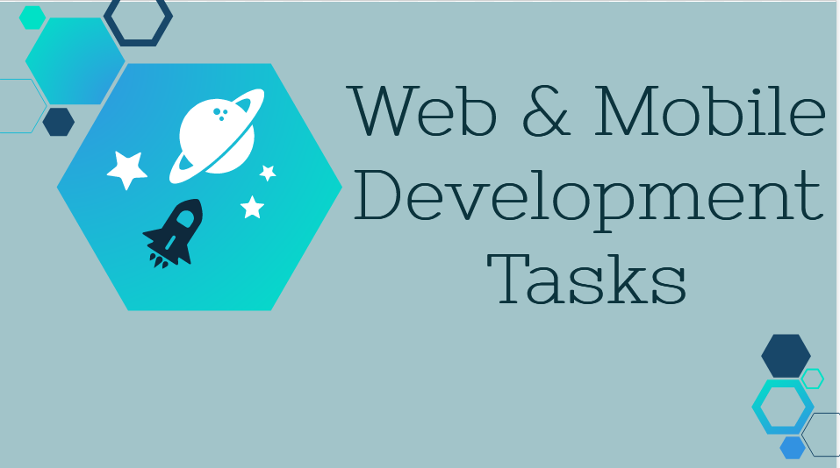

Slide 3
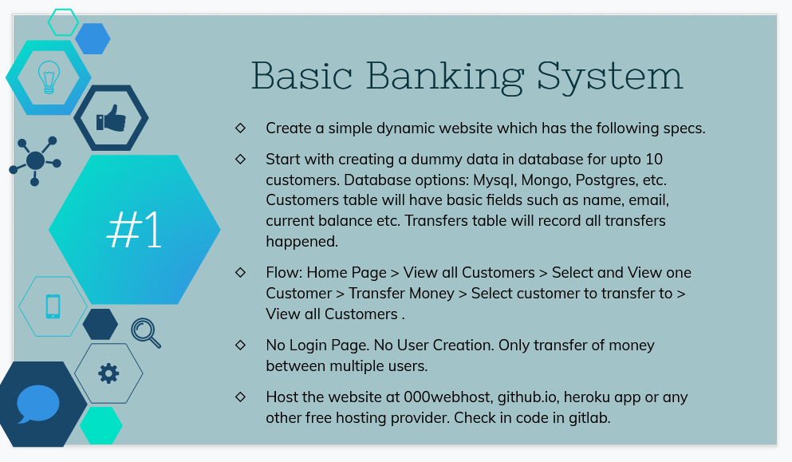
BASIC BANKING SYSTEM

Slide 4




LANGUAGES INVOLVED
FRONT END
BACKEND

Slide 5
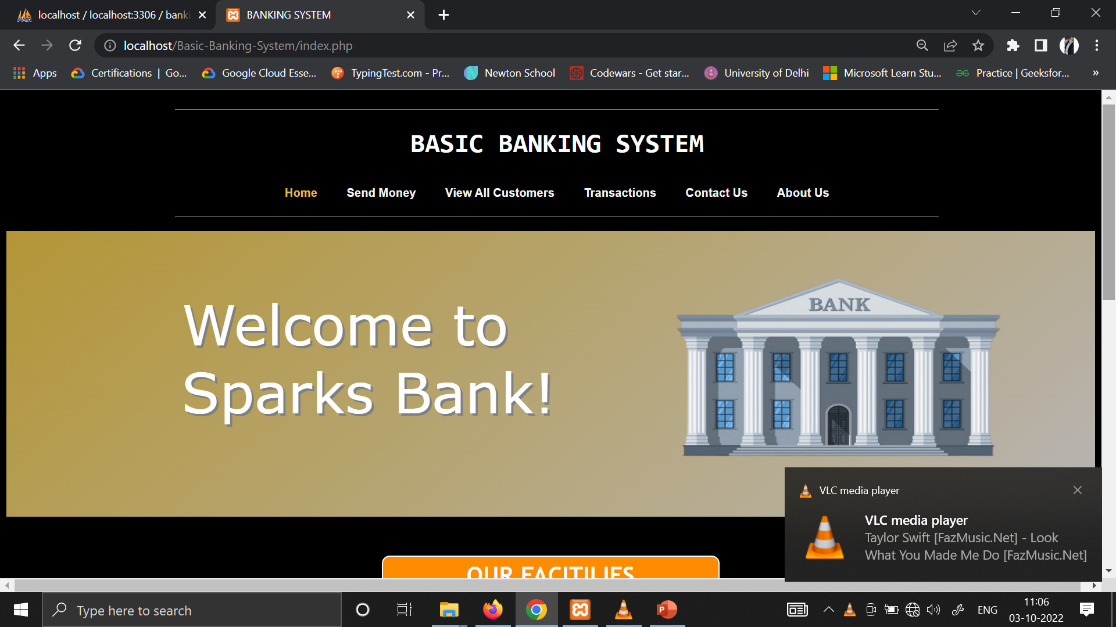
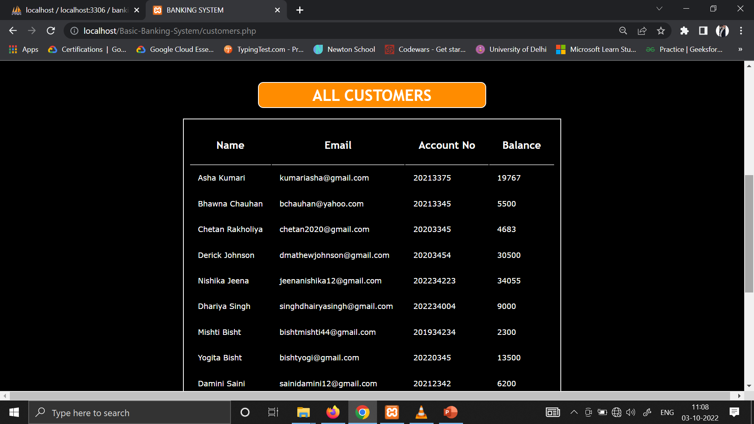
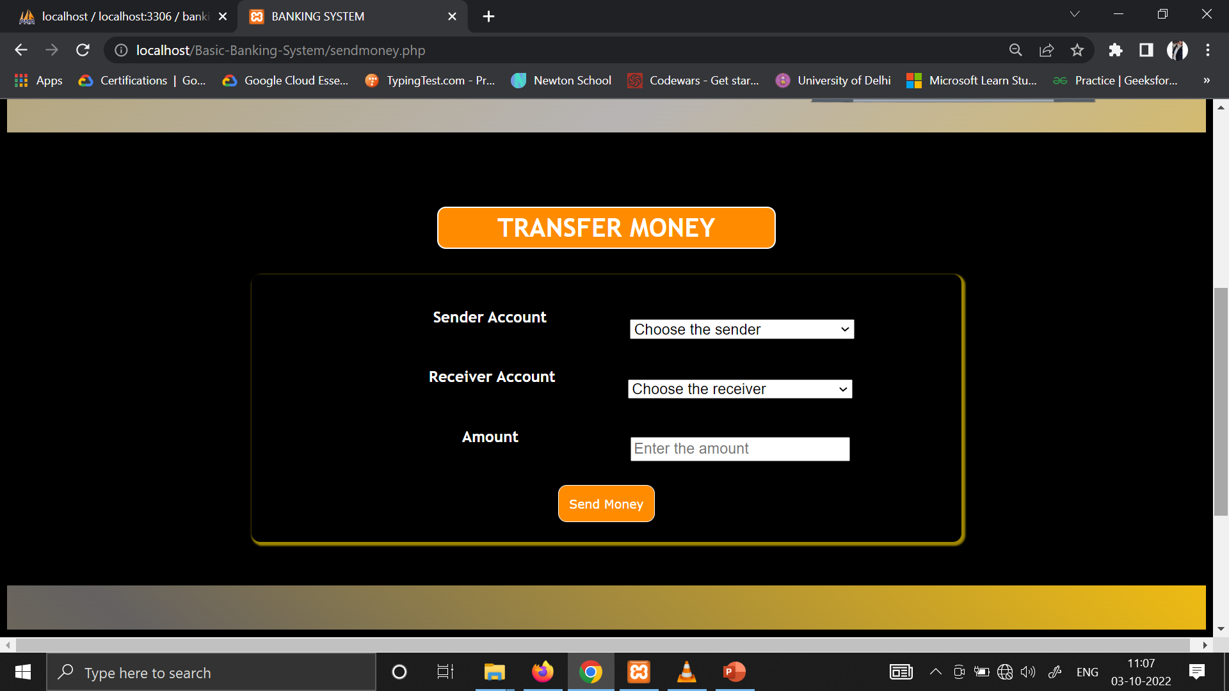
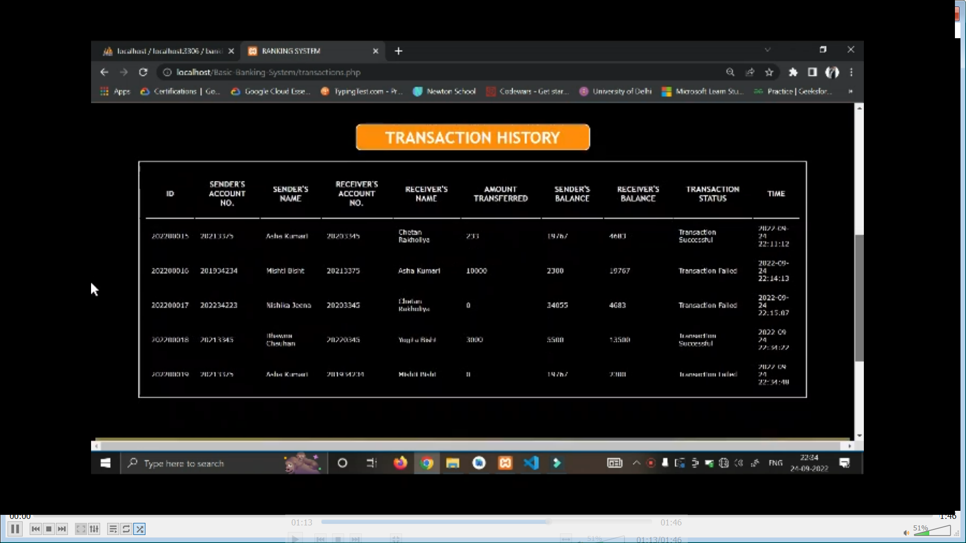
WEB PAGES

Slide 6
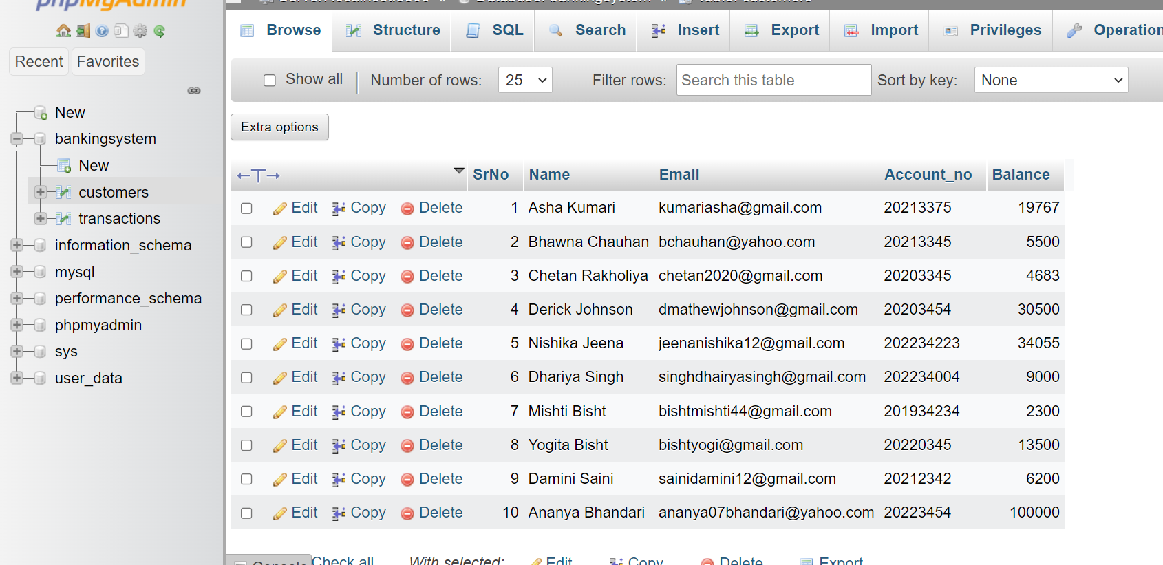
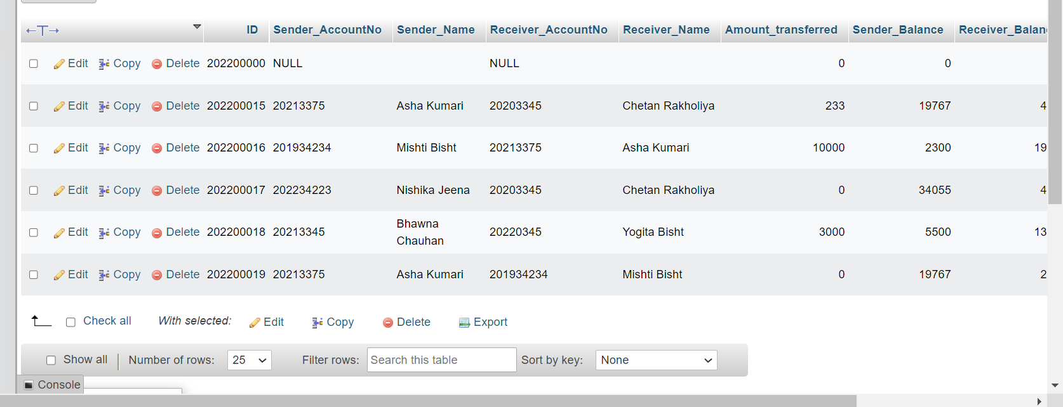
DATABASE

Slide 7
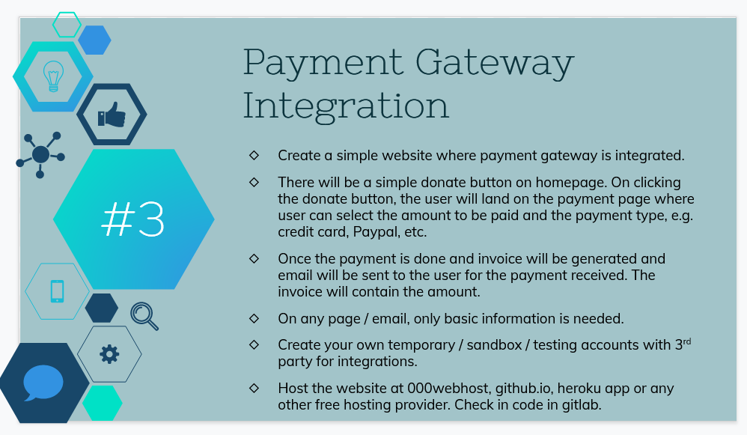
PAYMENT GATEWAY INTEGRATION

